Slide 1
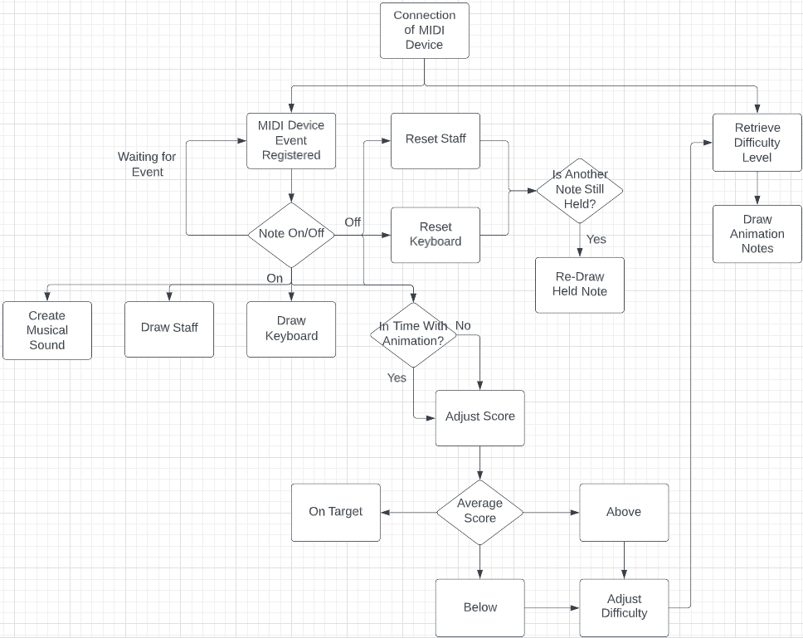
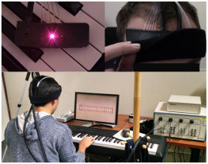
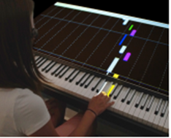
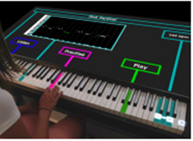
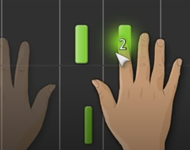
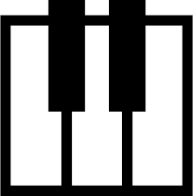
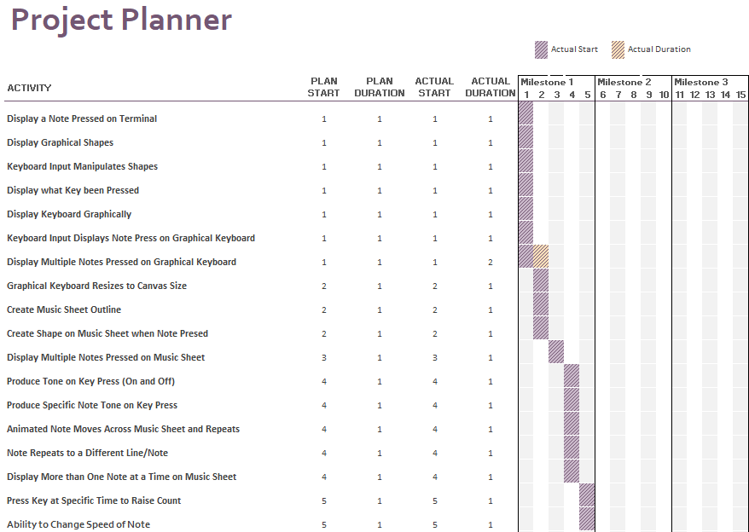
Creating a Responsive and Dynamic Piano Education Tool
What Is it?
Research
Research proves that we learn better once we reach a “zone of proximal development” which is better accessed through a responsive lesson opposed to a linear taught lesson (Yuksel et al., 2016).
Responsive lessons are adaptive to a users ability whereas a linear lesson is taught with a pre-planned path.
Similar Applications
Basic applications that teach using a linear path through the use of video tutorials to teach songs or how to read music such as ‘Harmony City’ and ‘Tenuto’.
My Project
To create an application that teaches users to how to read and play sheet music on a piano using a MIDI keyboard.
The application will keep score on whether the user is hitting the note on time or not and adjust the speed and difficulty based on this to enable users to reach the ‘zone of proximal development’.
It will be built by using JavaScript within HTML allowing ease of access if it were to be made a commonly accessible application. It would be accessible in all browsers that enable the capability of MIDI device input such as Edge, Chrome and Opera.
Method of Code
All actions for the application are dependent on the MIDI device input:
The sound comes from the note input being registered as a number from the MIDI device input.
The visual representation on both the keyboard and the staff comes from the note number given by the MIDI device input.
The difficulty is adjusted based on whether the user strikes the right note at the right time represented on the stave.
‘BACh’ is an application that measures users cognitive ability using a fNIRS sensor to adapt the lesson and allow the user to reach a ‘zone of proximal development’ (Yuksel et al., 2016).
‘P.I.A.N.O.’ has an interactive visualisation of the keyboard to help understand key notes on the keyboard and where users hands should be. It also has a rolling note visualiser for learning how to read music (Rogers et al., 2014).
‘Synthesia’ uses a MIDI keyboard input and has a note visualisation like ‘P.I.A.N.O.’. It contains a mass library of songs for users to learn, and also contains helpful hints for hand placement called “Finger Number Hints” (Synthesia Game, 2022).
Statistical Analysis
Project Management
Creating this project will be done so using the Agile approach, the project will be split into 3 milestones each with 5 bi-weekly sprints. The reviews at the end of each milestone will evaluate a Minimum Viable Product (MVP) and set new objectives by allowing user feedback from a varied audience to attain new scope for the development of the project. The varied audience will consist of both music literate and illiterate individuals.
Milestone 1: September 19th – January ????
Milestone 2: January ???? – March ????
Milestone 3: March ???? – May???

